Slide 1
WEEK 4: Agenda
STACK
QUEUE
WPS
2
of
15
Company Slogan

Slide 2
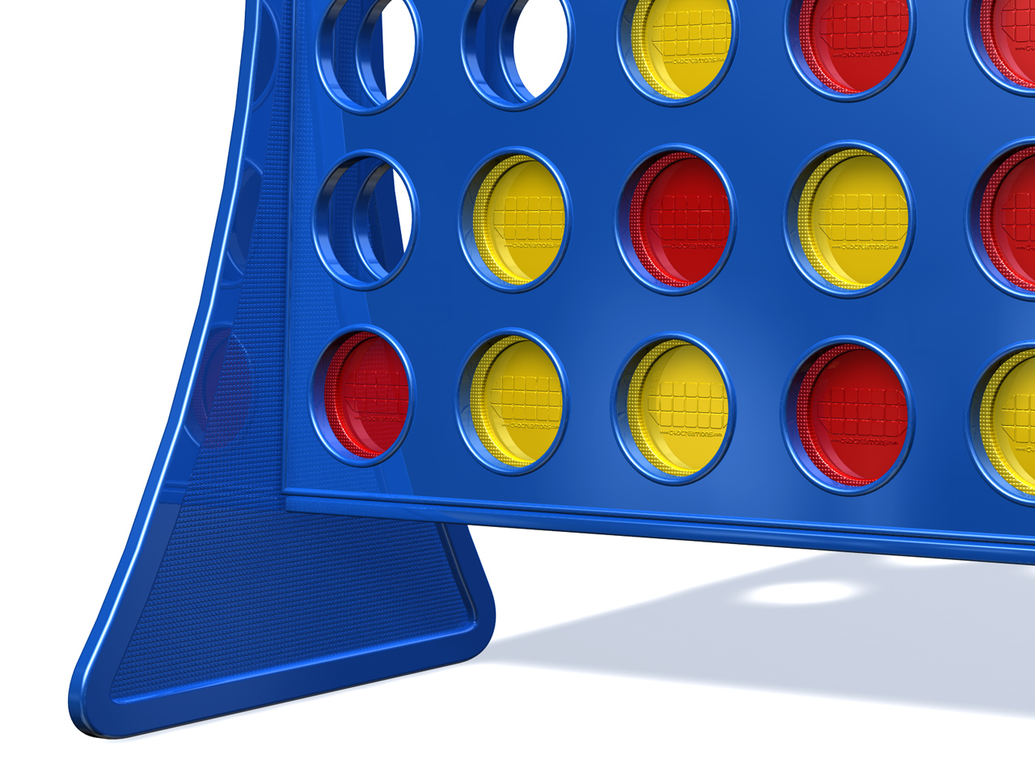
STACK
ABSTRACT DATA TYPE

Slide 3
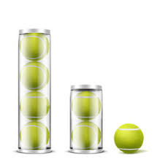

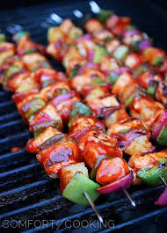
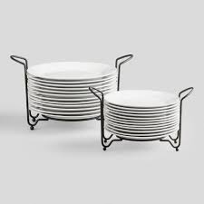

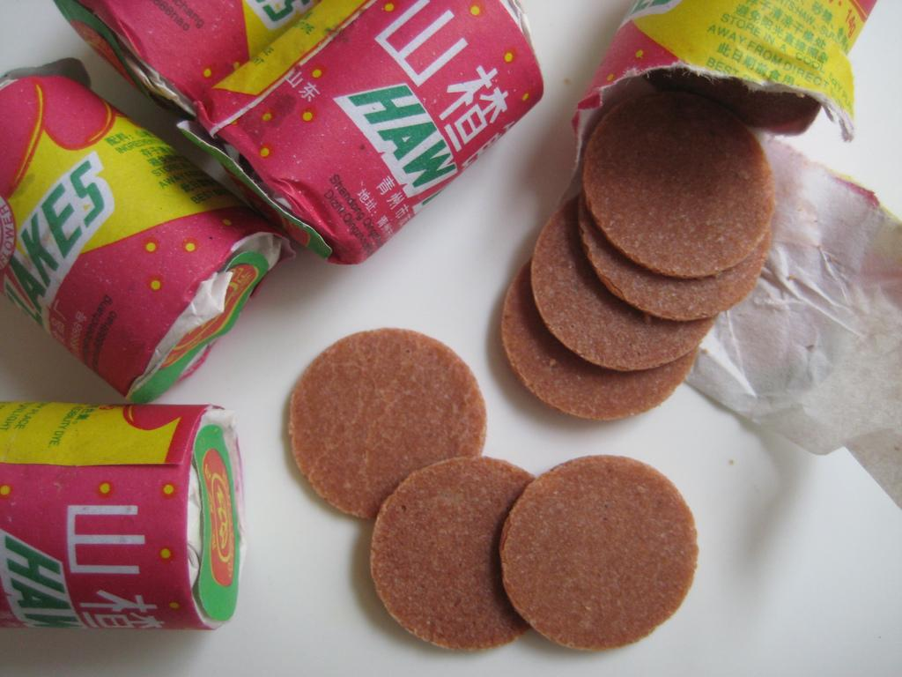
Stack depiction from real-wolrd objects
4

Slide 4
stack
last-in-first-out (LIFO)
adds and removes items at the top
operations
push
pop
top

Slide 5
stack
implementations
array
linked list

Slide 6
array implementation
top
0
1
2
3
4
5
6
7
8
9
10
11
12
size
initial values of
top and size?

Slide 7
array implementation - push (empty case)
push 45
top
0
1
2
3
4
5
6
7
8
9
10
11
12
size

Slide 8
array implementation - push (empty case)
push 45
top
45
0
1
2
3
4
5
6
7
8
9
10
11
12
size
size = 1
top = 0

Slide 9
array implementation - push
push -3
top
45
0
1
2
3
4
5
6
7
8
9
10
11
12
size
size = 1
top = 0

Slide 10
array implementation - push
push -3
top
45
-3
0
1
2
3
4
5
6
7
8
9
10
11
12
size
size = 2
top = 1

Slide 11
array implementation - push
push 17
top
45
-3
0
1
2
3
4
5
6
7
8
9
10
11
12
size
size = 2
top = 1

Slide 12
array implementation - push
push 17
top
45
-3
17
0
1
2
3
4
5
6
7
8
9
10
11
12
size
size = 3
top = 2

Slide 13
array implementation - push
push 1
top
45
-3
17
0
1
2
3
4
5
6
7
8
9
10
11
12
size
size = 3
top = 2

Slide 14
array implementation - push
push 1
top
45
-3
17
1
0
1
2
3
4
5
6
7
8
9
10
11
12
size
size = 4
top = 3

Slide 15
array implementation - push
push 29
top
45
-3
17
1
0
1
2
3
4
5
6
7
8
9
10
11
12
size
size = 4
top = 3

Slide 16
array implementation - push
push 29
top
45
-3
17
1
29
0
1
2
3
4
5
6
7
8
9
10
11
12
size
size = 5
top = 4

Slide 17
array implementation - push
push 94
top
45
-3
17
1
29
0
1
2
3
4
5
6
7
8
9
10
11
12
size
size = 5
top = 4

Slide 18
array implementation - push
push 94
45
-3
17
1
29
94
0
1
2
3
4
5
6
7
8
9
10
11
12
size = 6
top = 5

Slide 19
array implementation - push
push 57
top
45
-3
17
1
29
94
0
1
2
3
4
5
6
7
8
9
10
11
12
size
size = 6
top = 5

Slide 20
array implementation - push
push 57
top
45
-3
17
1
29
94
57
0
1
2
3
4
5
6
7
8
9
10
11
12
size
size = 7
top = 6

Slide 21
array implementation - pop
top
45
-3
17
1
29
94
57
0
1
2
3
4
5
6
7
8
9
10
11
12
size
size = 7
top = 6

Slide 22
array implementation - pop
top
45
-3
17
1
29
94
57
0
1
2
3
4
5
6
7
8
9
10
11
12
size
size = 6
top = 5

Slide 23
array implementation - pop
top
45
-3
17
1
29
94
57
0
1
2
3
4
5
6
7
8
9
10
11
12
size
size = 5
top = 4

Slide 24
array implementation - pop
worrisome 94 and 57?
top
45
-3
17
1
29
94
57
0
1
2
3
4
5
6
7
8
9
10
11
12
size
size = 5
top = 4

Slide 25
array implementation - push 35
top
45
-3
17
1
29
94
57
0
1
2
3
4
5
6
7
8
9
10
11
12
size
size = 5
top = 4

Slide 26
array implementation - push 35
top
45
-3
17
1
29
35
57
0
1
2
3
4
5
6
7
8
9
10
11
12
size
size = 6
top = 5

Slide 27
array implementation - push 68
top
45
-3
17
1
29
35
57
0
1
2
3
4
5
6
7
8
9
10
11
12
size
size = 6
top = 5

Slide 28
array implementation - push 68
top
45
-3
17
1
29
35
68
0
1
2
3
4
5
6
7
8
9
10
11
12
size
size = 7
top = 6

Slide 29
try and implement the array implementation for stack
include functions push and pop; also display the size of array and position of top and its value.
Also include a mechanism that will not allow pushing or popping of item when stack is full or when stack is empty

